Slide 1
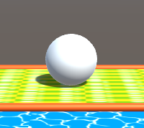
MAGIC MONKEY MARBLE
A Game Development Project By: Jared Jones, Stephen Phipps, Grant, Kyle Greer, and Andrew Gray

Slide 2
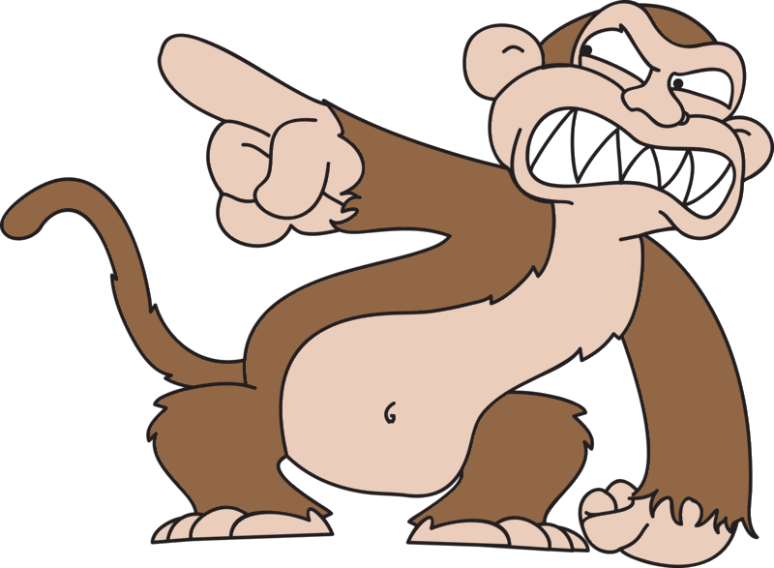
Introduction
Game Objective
Title Screen
Player
Unique Levels
Power Ups
Enemy

Slide 3
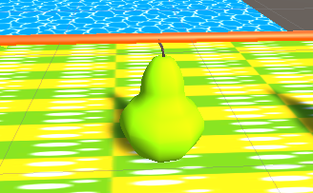
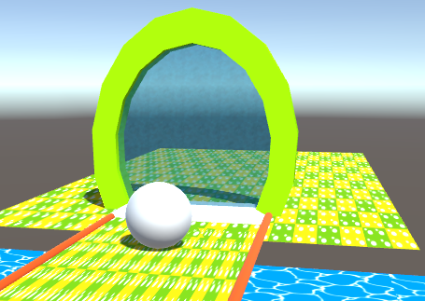
Game Objective
The objective of Magic Monkey Marble is to roll the Marble or player through the marble portal and collect Pears along the way
If a player falls off the platform and hits the ground below, the scene will restart
Collectable Pear
Marble Portal

Slide 4
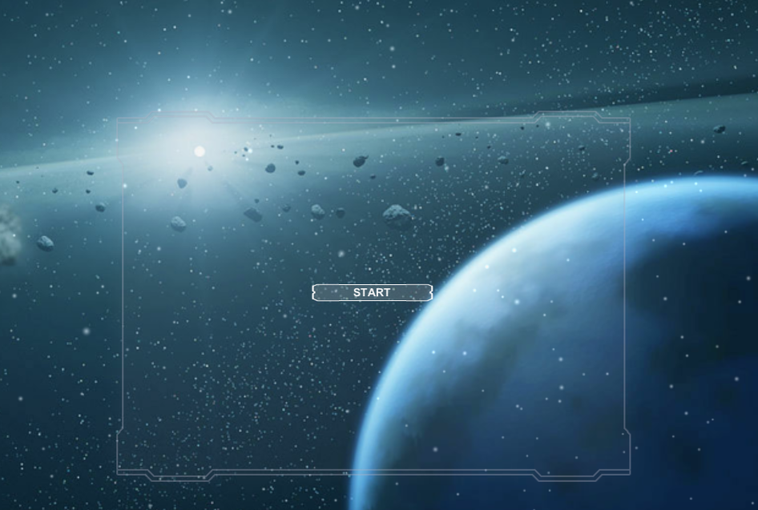
Title Screen
Magic Monkey Marble has a unique transitioning title screen
When the start button is pressed the scene transitions to the start of the game
Title screen also has audio attached to it

Slide 5
Player
You enter the world as Marble
You are able to control and navigate through our unique world with the W A S D keys
Marble

Slide 6
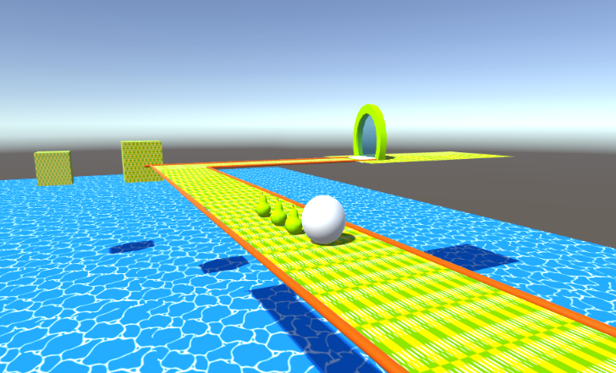
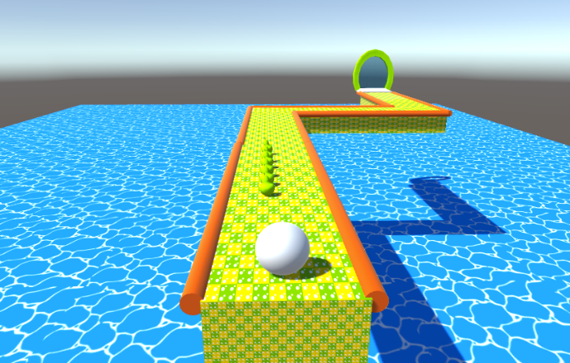
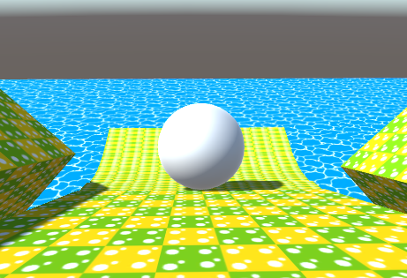
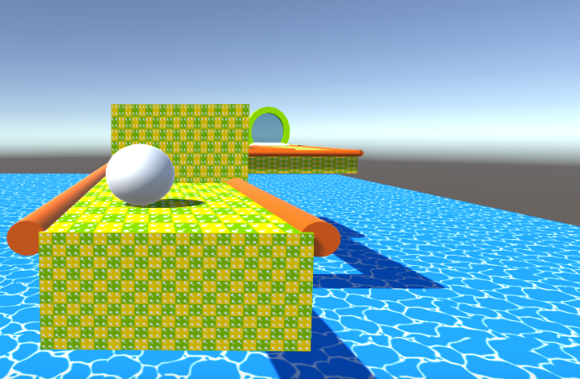
Unique Levels
Magic Monkey Marble has four unique levels and a final stage
Level 1
Level 2
Level 3
Level 4

Slide 7
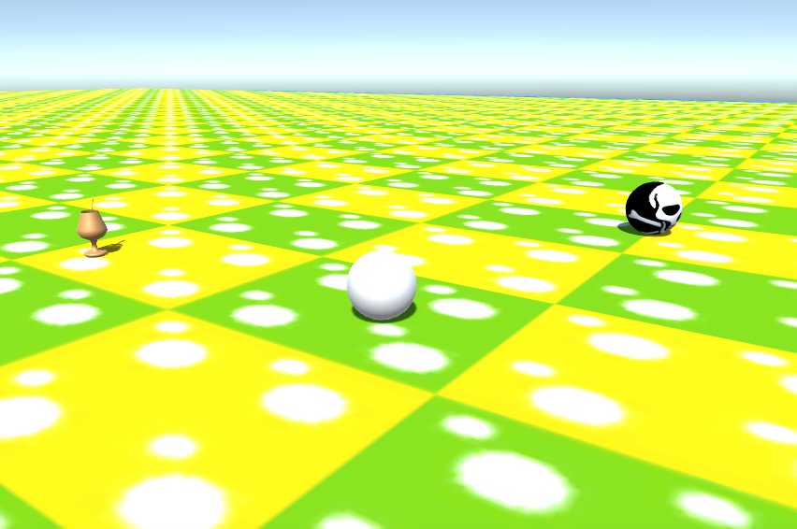
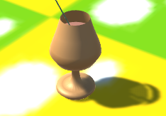
Power Ups and Final Stage
The final stage is a combat stage and contains a Goblet which is a speed power up
Goblet increases speed by a factor 4
Final Stage
Goblet Power Up

Slide 8
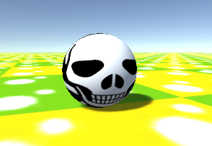
Enemy and AI
The enemy of the game comes into play during the final stage
Goal is to stay away from Mean Marble
If Mean Marble touches Marble then the stage restarts
Mean Marble implements a seek script which follows Marble
Mean Marble

